Slide 1
Renewable Energy for a Sustainable Future
November 8^{th,} 2023

Slide 2
Agenda
Introductions
Emissions-Free Energy Options
Complications of Renewable Energy Options
Forward-Looking Questions for a Sustainable Future
Some Possibilities in Development

Slide 3
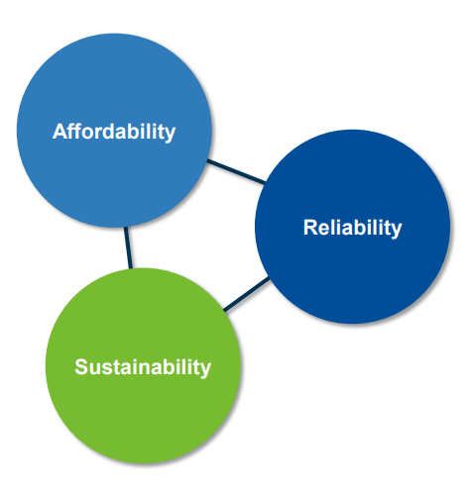
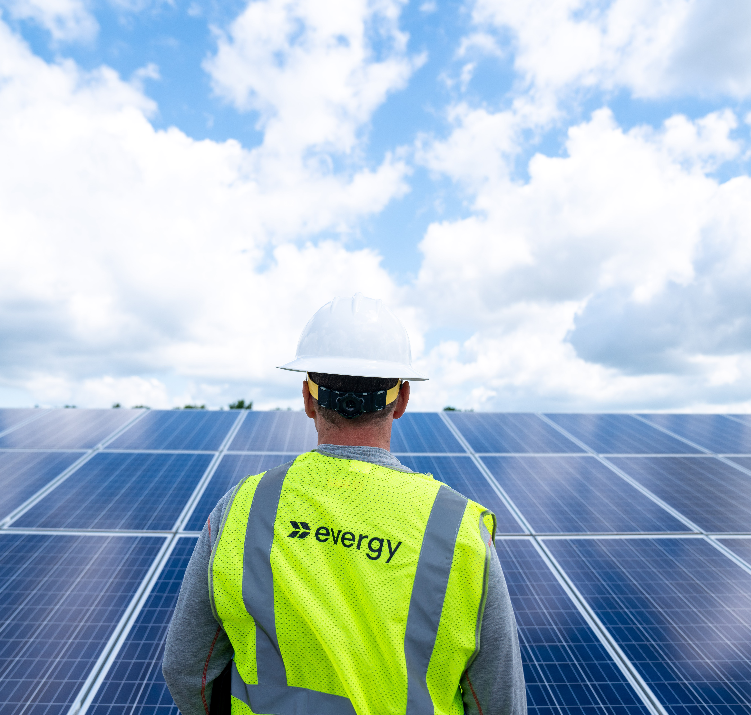
Evergy Guiding Principles

Slide 4
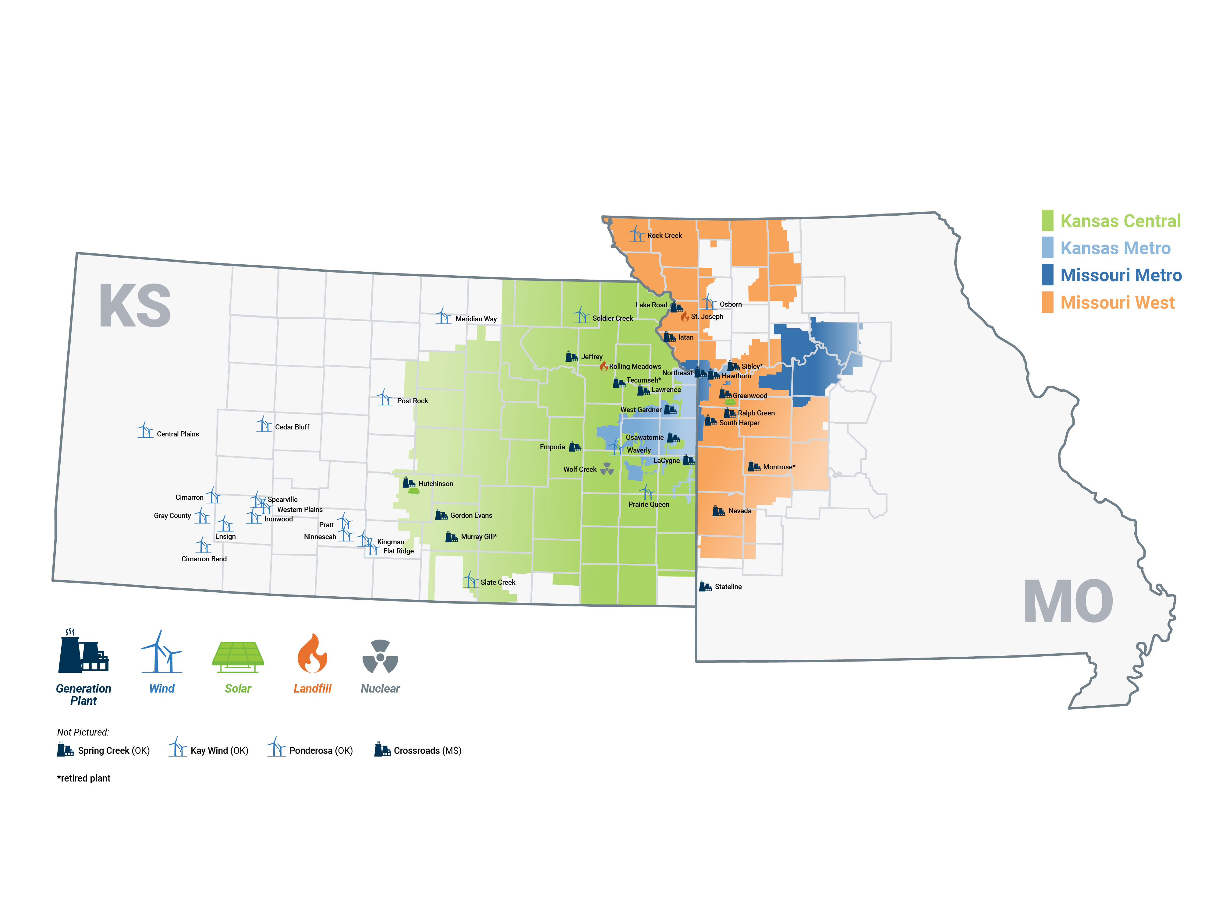
Combined Service Territory
Notes:
Our service territory Eastern Kansas and Western Missouri.
The contiguous service territories were a key factor in our decision to merge KCP&L and Westar Energy.

Slide 5
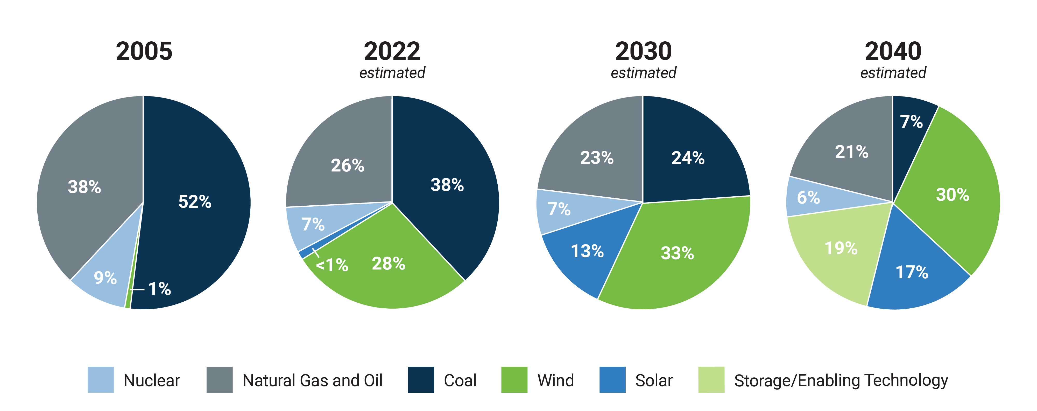
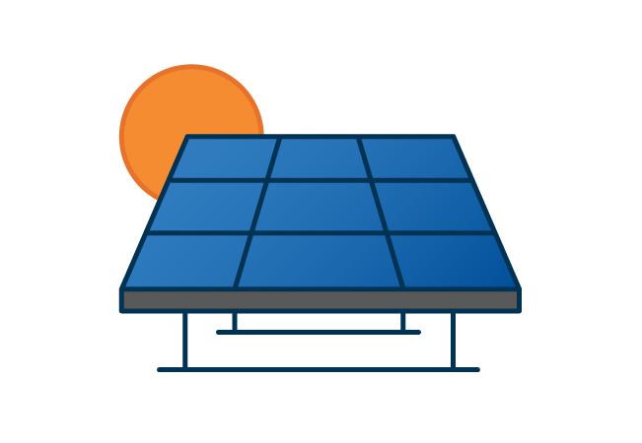
Generation capacity by fuel type over time
2,290 MW of solar
1,250 MW of wind
1,905 MW of coal retirements

Slide 6
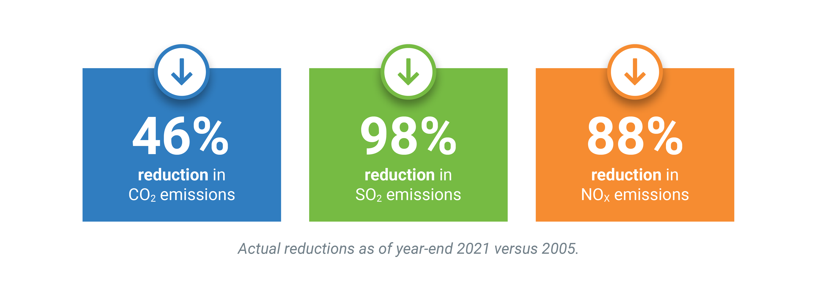
Air Impacts: Clean Energy Transition
50% Carbon-Free Energy in 2020
51% CO₂ Reductions since 2005
Wind
2020 Energy Mix
Other Renewables
1%
Nuclear
Fossil
2005
2010
2015
2020

Slide 7
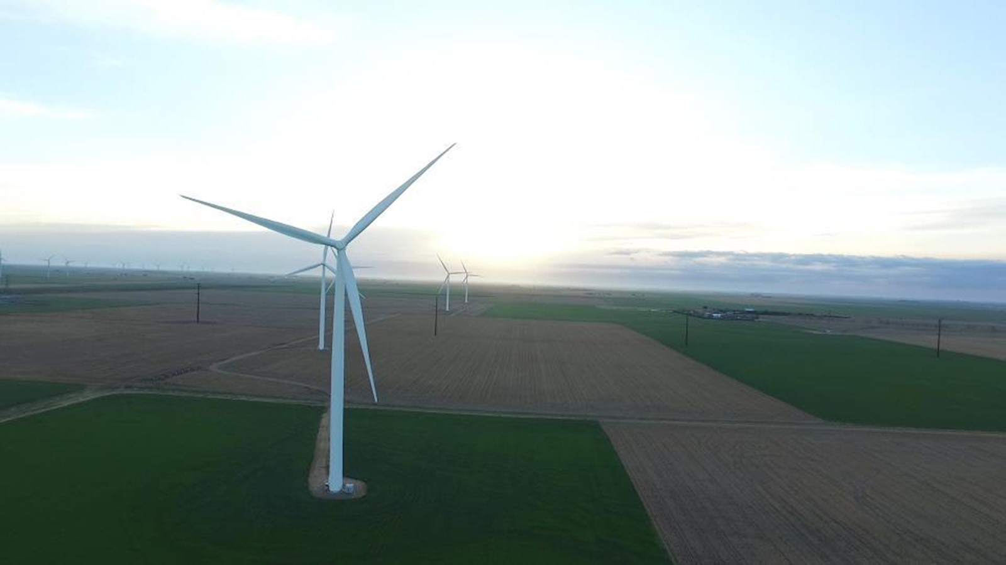
Wind Development

Slide 8
Wind v.s. Load Demand

Slide 9
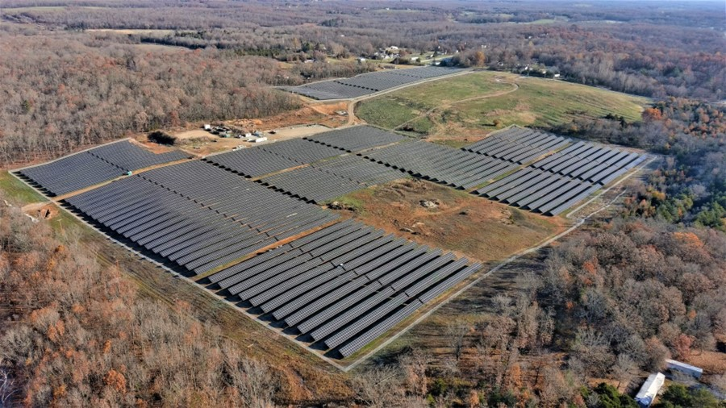
Solar Development

Slide 10
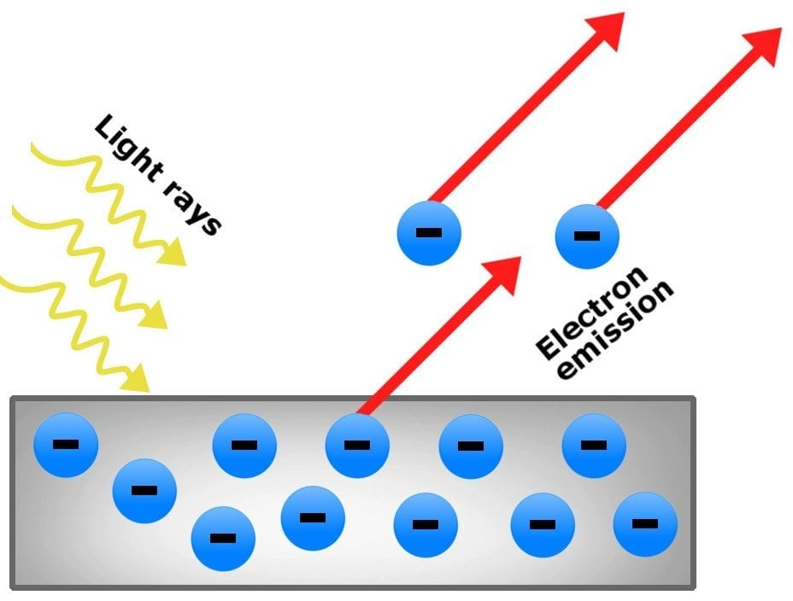
Photoelectric Effect

Slide 11
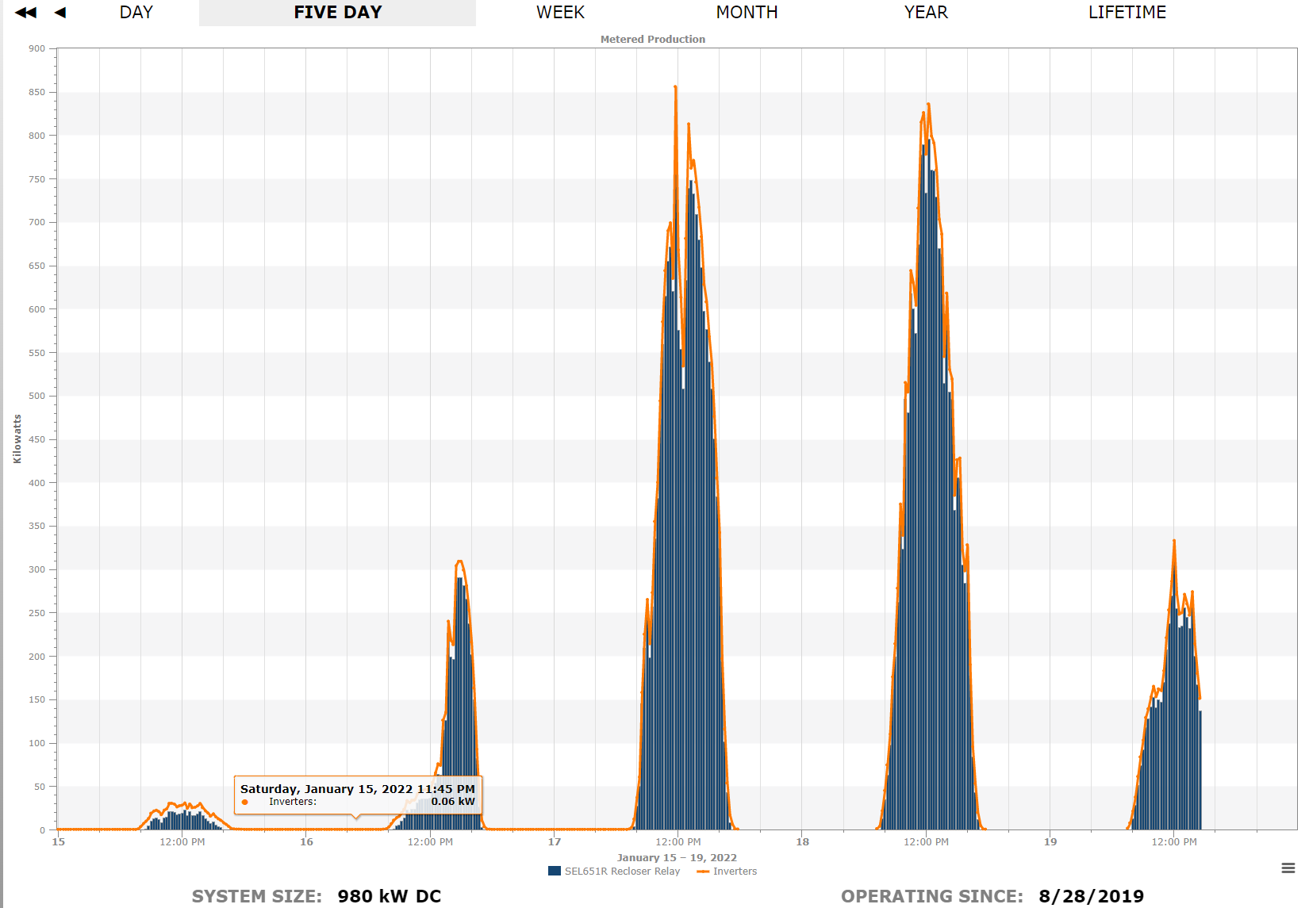
Solar Generation Profile

Slide 12
For a Sustainable Future
Forward-Looking Questions
What will supply our base load?
How can we efficiently store solar and wind energy?
How can our fossil generation be more sustainable?

Slide 13
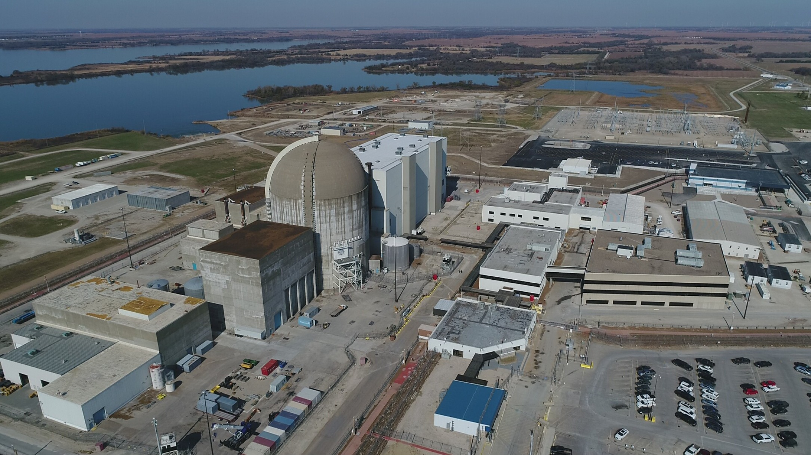
What will supply our base load?
Wolf Creek Generating Station (1,200 MW Capacity)
BWRX-300 Small Modular Reactor “SMR”
(300 MW Capacity)

Slide 14
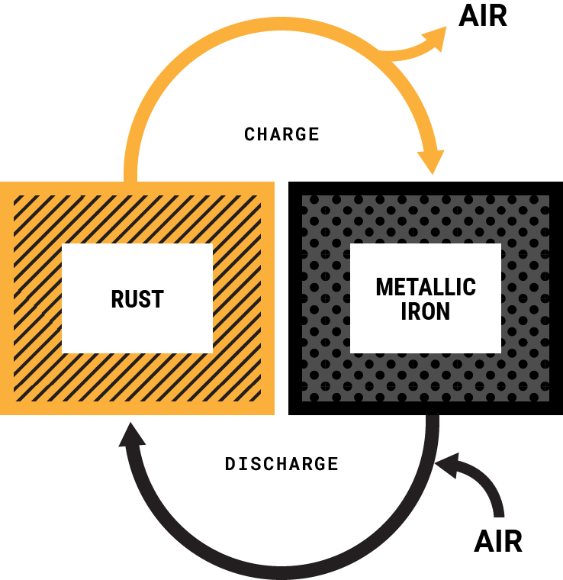
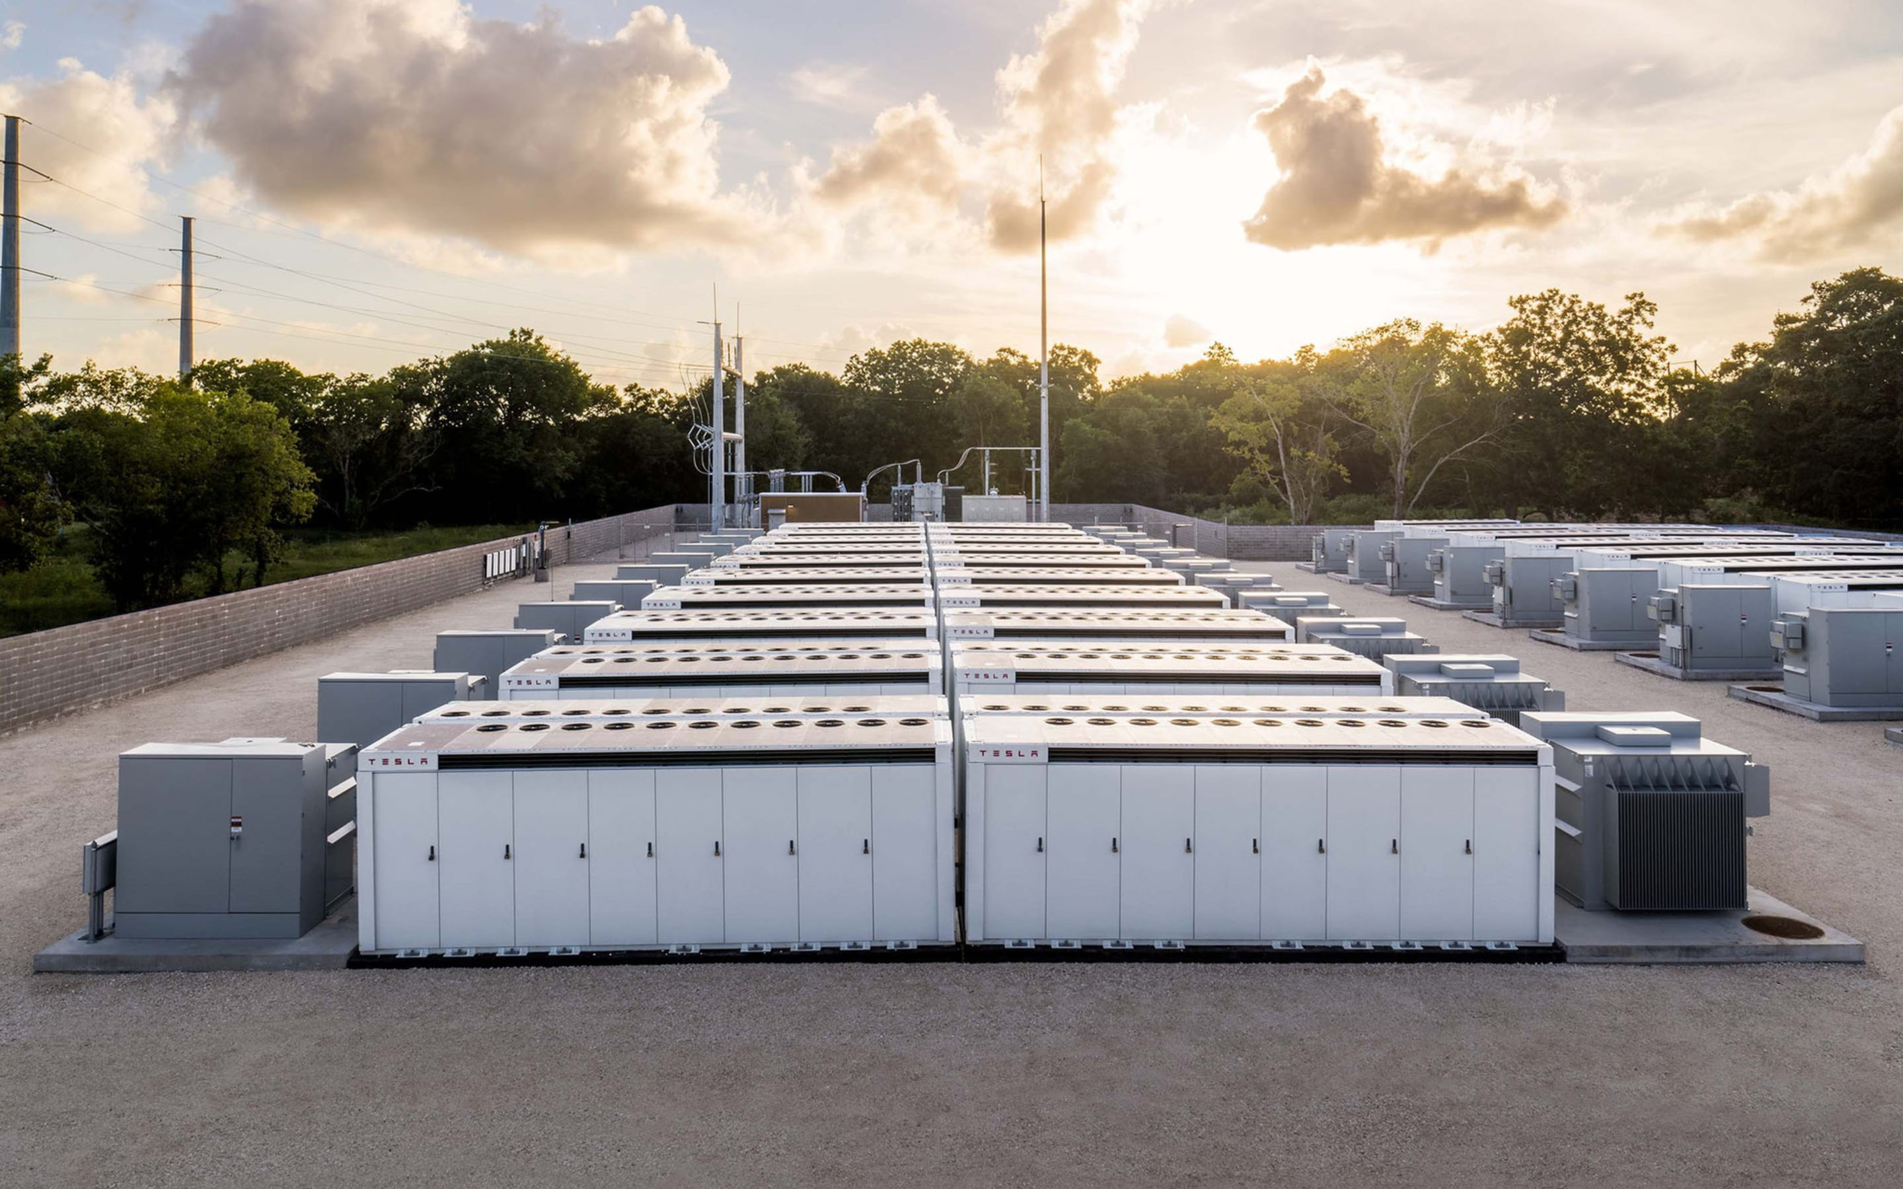
How can we efficiently store solar and wind energy?
Tesla Megapack
(3 MWh per battery)
Form Energy Iron-Air Battery
(100+ hour duration)

Slide 15
References
https://www.scienceabc.com/pure-sciences/what-explain-photoelectric-effect-einstein-definition-exmaple-applications-threshold-frequency.html
BWRX-300: https://nuclear.gepower.com/bwrx-300
Tesla Megapack: https://www.tesla.com/megapack
Form Energy: https://formenergy.com/technology/battery-technology/

